Slide 1

APAC Innovation
August 2025

Slide 2
APAC Innovation
APAC Innovation to Accelerate Sales Growth
2026 $
Drive Booking by Leveraging CIC Systems
Elevate Technology Capabilities via Engineering Chapter
Leverage existing CIC developed systems & content
Support key accounts and break-through programs
Enable architectural leverage and technical sharing
Enable x-function teaming through technical board meetings

Slide 3
Leverage CIC Systems

Slide 4
IC4C Focus Areas
SEBU
ADG & PBU
TBU
Solutions
McVST STS improvement
High-speed ADC
eVTOL
ADAS & IVI
Complex Systems
PMIC
Optoelectronics / SiPho
Semi Research
EV Powertrain
mmWave / RF
Simple Systems
HIL
Partner / OEM Program
Academic Adoption Program
Products / Platform
Intelligent Test (AI Exploration)
IC4C Product / Platform Focus (reference architecture, case study, etc.)
Engineering
Capabilities
MS (SMU)
FPGA
RF
Intelligent Test
Hardware
Peripheral
Real-time
VeriStand, Model
High Digital
Camera
High Power
PATools
Notes:
Resource
Initiatives
体现出changes
Content & GTM
Growth Manager

Slide 5
CIC Focus Projects and Initiatives
China Specific Systems
Multi-Channel PMIC Ref. Solution
Open-PXI For RF APT with VST3&VNA
Ecosystem Co-innovation
SiC KGD Test
Optical Comm.
Broad-base Expansion
AI for Academic Teaching
LabVIEW CSM
Vanchip McVST EAP solution improvement
China V-COM
IVI Test System
ADAS Video Octopus
Solid State Battery
PowerTrain (PATools + PXI)​
Semi Research – Parametric
Sub-THz RDP Ref. Solution
Product Example USRP X410 and PXIe-790x Streaming
RF Record and Playback
Non-export controlled MM1 STS/PXI solution
Intelligent Test Exploration
CentOS 7.9 support on PXIe-8862
HIL & SC
Establish China Project Execution Process to govern ROI
85% projects:
Investment < 6 Dev-M
Duration < 6 M
Largest investment:
13.3 Dev-M
Avg. ROI: > 8
Notes:
Build systems tailored to the unique needs for China market.
Expand and safeguard our business for broad base products and platform in China’s increasingly competitive landscape.
Foster innovation through collaboration with the broader ecosystem in China's prominent and emerging sectors

Slide 6
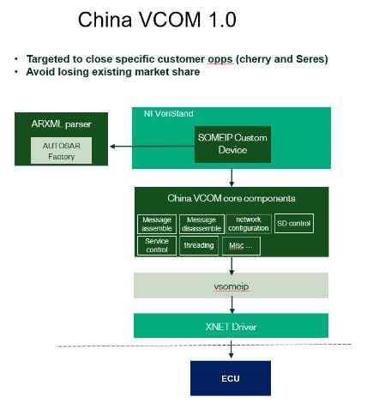
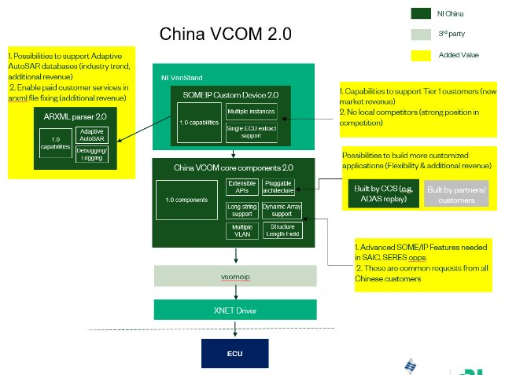
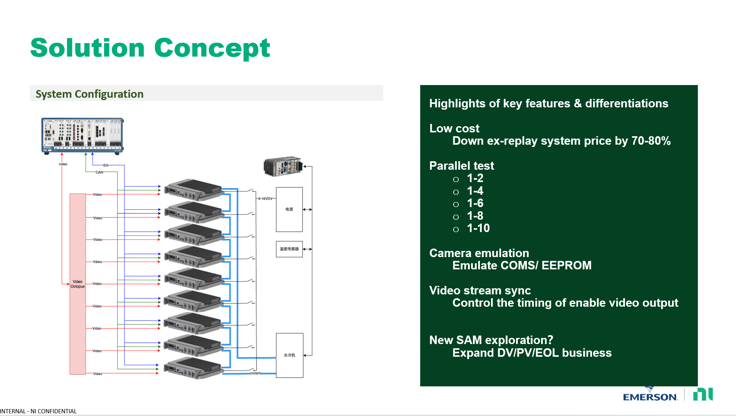
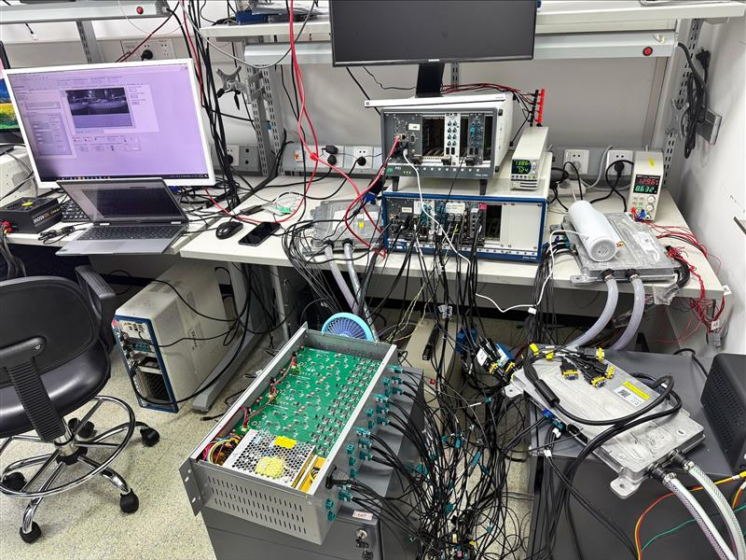
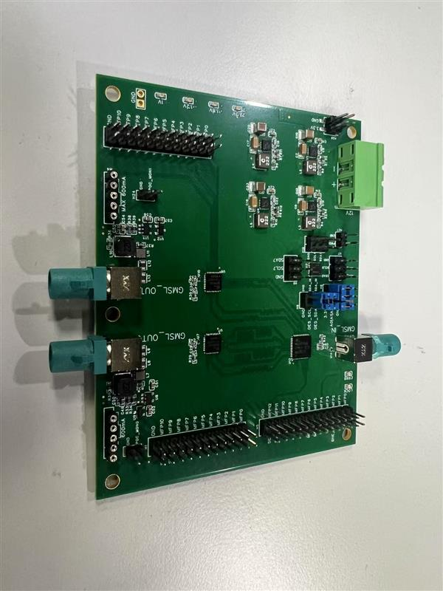
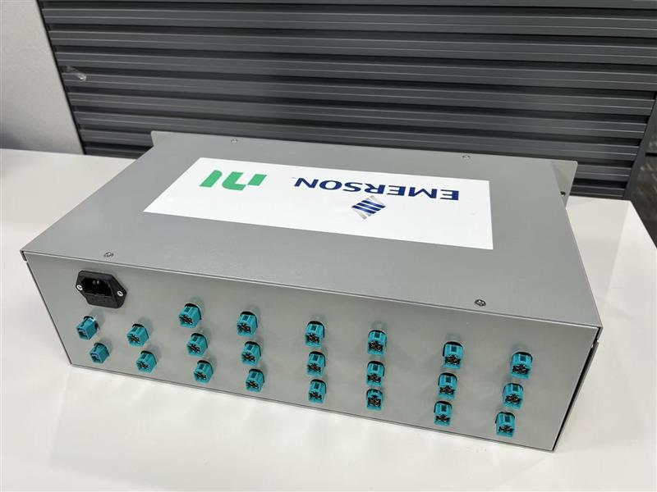
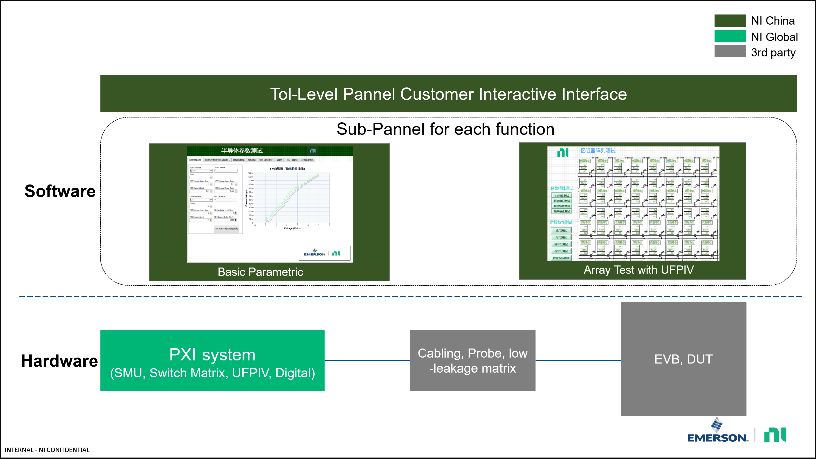
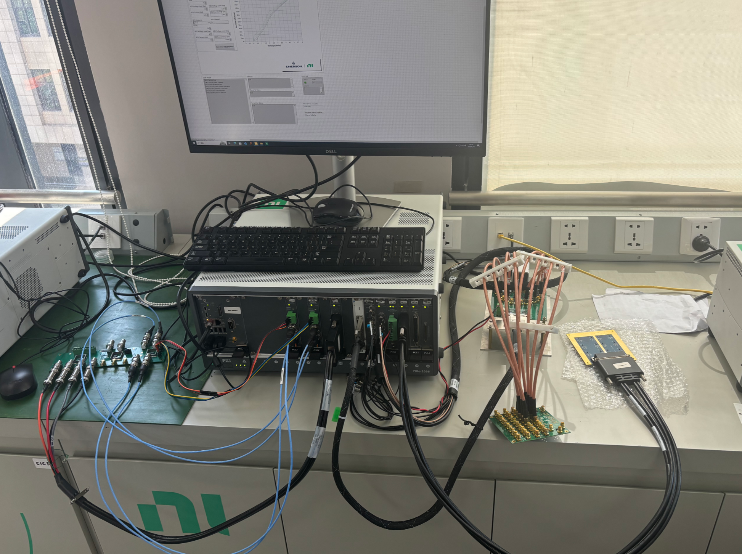
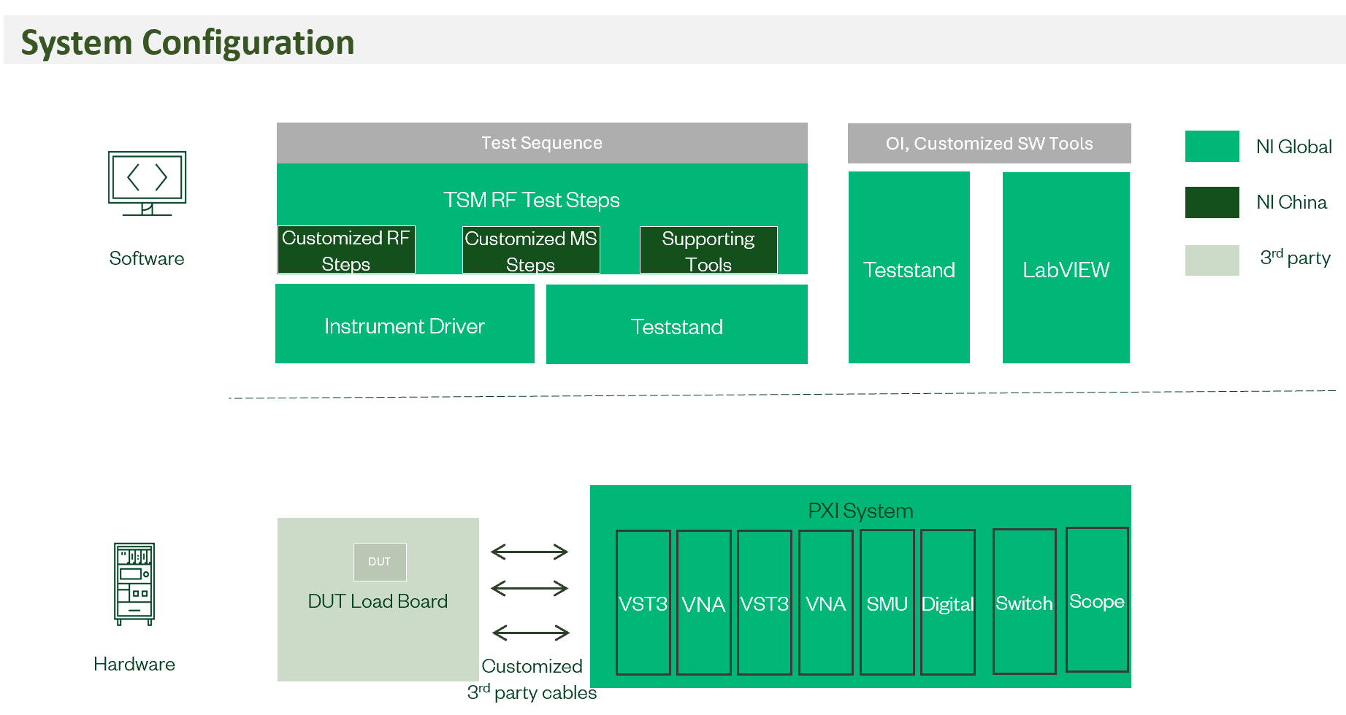
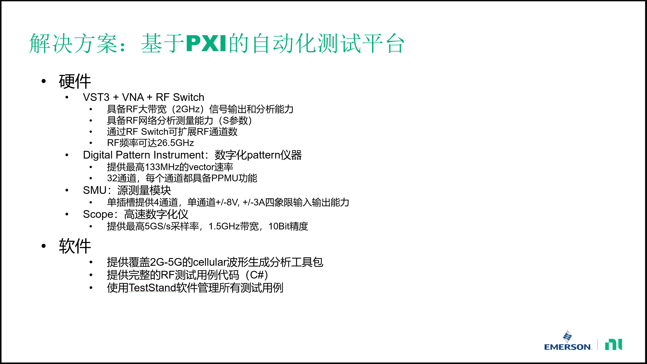
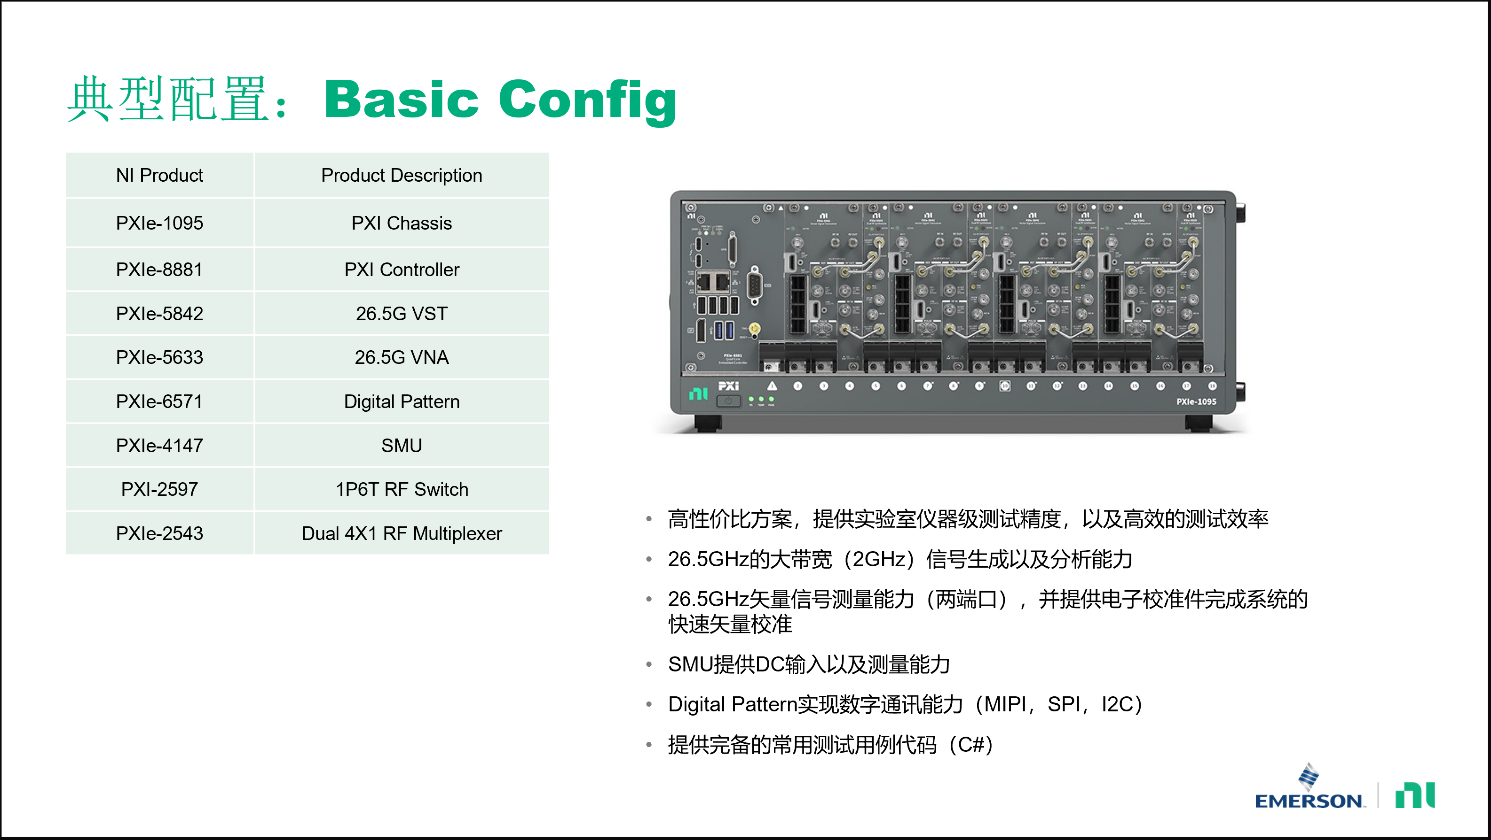
China Local Innovative Solutions
Project | BU | Business Impact 3Y | FTE (Dev-Months) | Growth Manager | RTM | Status
Multi-Channel PMIC Ref. Solution | SEBU | 1.2M | 1.5 | Yingliang Mo | NI | C-Launch
Open-PXI For RF APT with VST3&VNA | SEBU | 3.3M | 1.5 | Yingliang Mo | NI | C-Launch
SiC KGD Test | SEBU | 1.23M | 2.9 | Yingliang Mo | Partner | PEA
[SEBU PSG] Vanchip McVST EAP solution improvement | SEBU | 1.06M | 2 | Ye Sun | NI | PEA
Optical | SEBU | 14.3M | 2.5 | Min Tang | Partner | PEA
China V-COM 1.0 | TBU | 3M | 10 | Shuai Wang | NI | C-Launch
HIL Core FPGA &SC 1.0&1.1 | TBU | 2M | 9.8 | Shuai Wang | Partner | C-Launch
IVI Test System | TBU | 0.8M | 1 | Shuai Wang | Partner | PDA
China V-COM 2.0 | TBU | 3M | 3.5 | Shuai Wang | NI | C-Launch
ADAS Video Octopus | TBU | 6.2M | 4.5 | Shuai Wang | NI | PEA
HIL Core FPGA &SC 2.0 | TBU | 2M | 13.3 | Shuai Wang | Partner | PDA
China V-COM 2.1 | TBU | 3M | 2 | Shuai Wang | NI | PEA
Solid State Battery | TBU | 3.3M | 1.5 | Feng Zhou | NI | PI
PowerTrain (PATools + PXI)​ | TBU​ | ​5M | 3 | Feng Zhou​ | Partner​ | ​
Semi Research – Parametric | PBU | 6.5M | 4 | Yingliang Mo | Partner | C-Launch
Sub-THz RDP Ref. Solution 25.0 | PBU | 2M | 4 | Hang Cao | Partner | C-Launch
China VCOM 1.0 & 2.0
ADAS Video Octopus
Semi Research – Parametric
VST3+VNA Open-PXI Solution

Slide 7
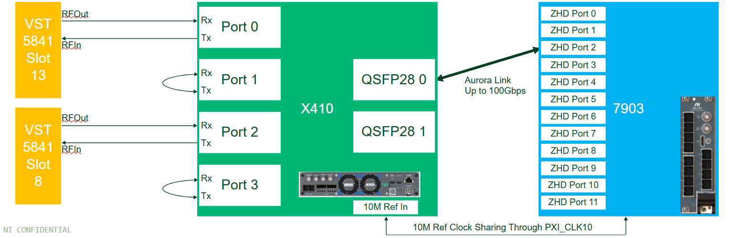
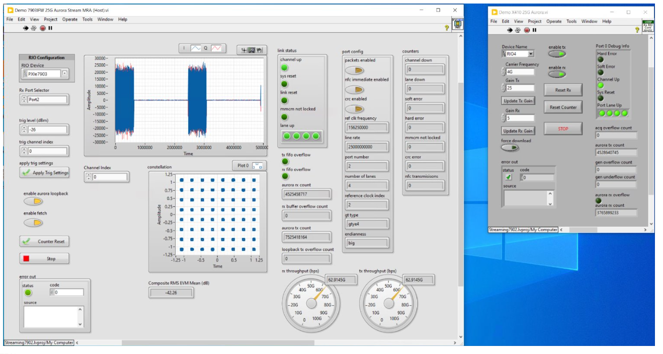
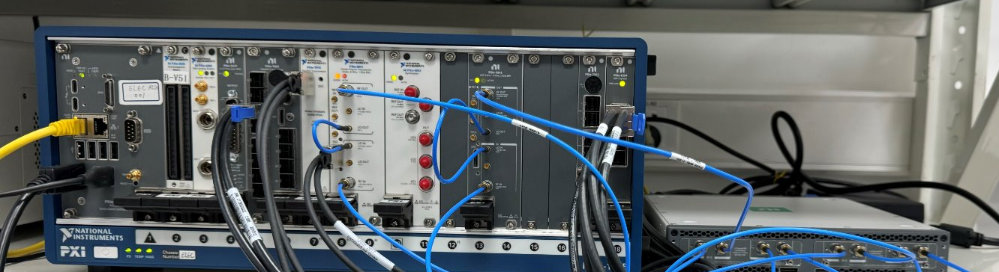
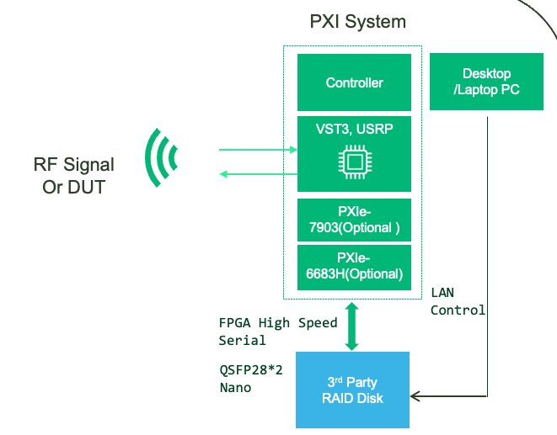
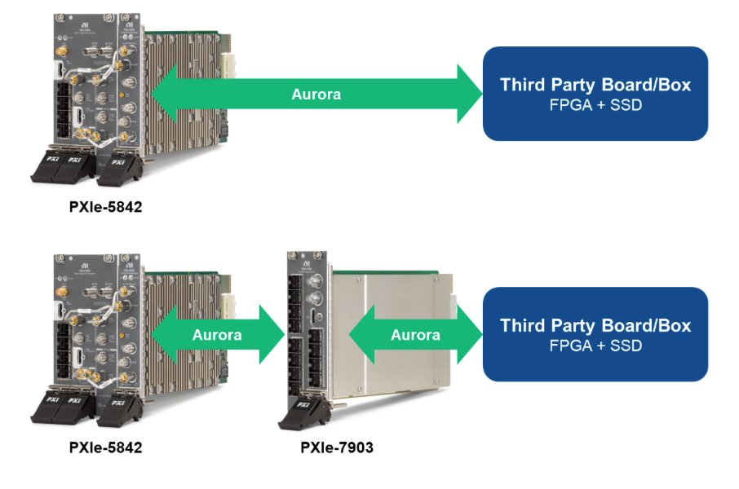
China Local Innovative Solutions
Project | BU | Business Impact 3Y | FTE (Dev-Months) | Growth Manager | RTM | Status
Product Example USRP X410 and PXIe-790x Streaming | xBU | 1.2M | 1 | Hang Cao | NI/Partner | C-Launch
Non-export controlled MM1 STS/PXI solution | xBU | 15M | 6 | Hang Cao | NI | PI
ISAC | xBU | 1M | 3 | Hang Cao | NI/Partner | PI
RF Record and Playback | xBU | 3M | 4.75 | Hang Cao | NI/Partner | PPA
AI Exploration/Intelligent Test | xBU | TBD | 3 | Lincoln Lin | NI/Partner | PI
CSM Doc 1.0 | xBU | TBD | 2.3 | Chen Shen | NI | PEA
CentOS 7.9 support on PXIe-8862 | xBU | TBD | 1.5 | Chen Shen | NI | C-Launch
USRP X410 and PXIe-790x Streaming
RF Record and Playback

Slide 8
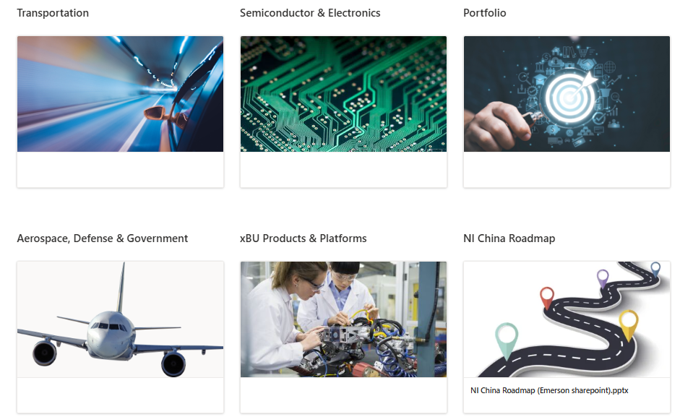
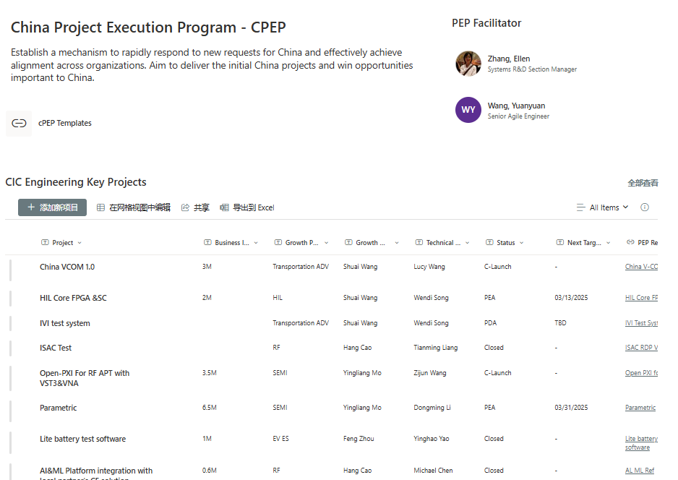
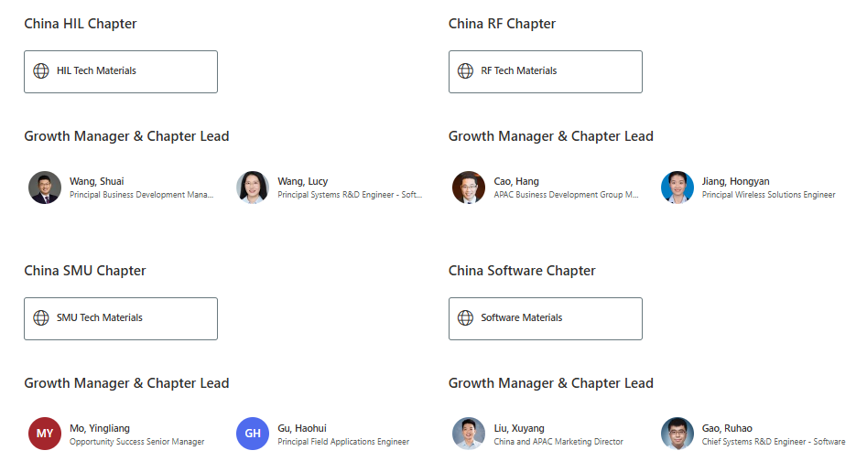
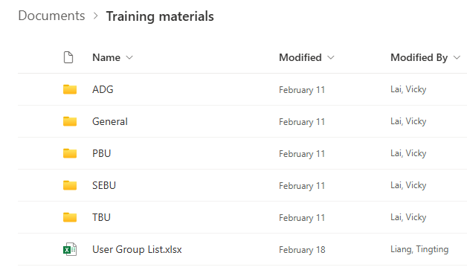


IC4C SharePoint Overview (Link)
Success Cases & Progress
China version of ShowPad
IC4C Solutions
and Products
China Project Execution Program
Engineering Chapter
Customer Training Materials
NI China Narrative Slide Deck
Market Insights

Slide 9
IC4C SharePoint Overview (Link)
China Version of ShowPad
Get the localized content
Various types of content (flyers, brochures, customer-facing slides, case studies, application notes, training videos, social media links etc.)
Find the right person
The SharePoint consists of different pages, where you can find the contacts for different purposes, e.g.
Allow sales to tailor for different scenarios (customer visit, session speech, solution proposal, etc.)
Go to technical marketers if you need any specific content;
Go to administrators for support on a PEP application,;
Sales can also request for specific content.
Go to growth managers for opportunity pursuing or technical support;
Go to market specialists for a specific market report.
Check out the ongoing process
All the IC4C ongoing PEP projects and related information can be found there.
Sales can check out the progress and see if any existing projects could support on pursuing opportunities.
Sales’ feedback is highly appreciated and can trigger a new PEP project.

Slide 10
IC4C SharePoint Layout

Slide 11



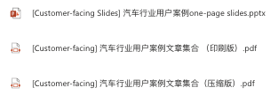
How IC4C Supports Sales
If you are a salesperson in automobile industry
If it is your first visit, you may want to introduce NI and NI’s achievements in automobile industry, you can go to:
IC4C SharePoint Homepage >> NI Company & Business Introduction
If you need to show customers NI’s capabilities in automobile industry, you can go to:
IC4C SharePoint Homepage >> Case Studies >> [Customer-facing] 汽车
If you want to show a specific solution such as “smart camera test solution”, you can go to:
IC4C SharePoint Homepage >> TBU >> [ADAS] Smart Camera Test Solution
Customer Visit
One-page Slides & User Case Study Article Set

Slide 12
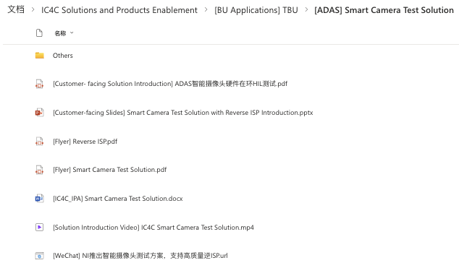
How IC4C SharePoint Supports Sales
If you are a salesperson in automobile industry
A specific solution folder consists of several items of the following:
Customer-facing Slides
Solution Introduction Video
Demo Video
Flyer
Brochure
WeChat Promotion Link
IPA
Application Notes
Case Studies
…
Take the “Smart Camera Test Solution” as an example:

Slide 13
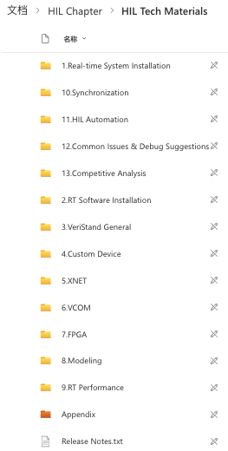

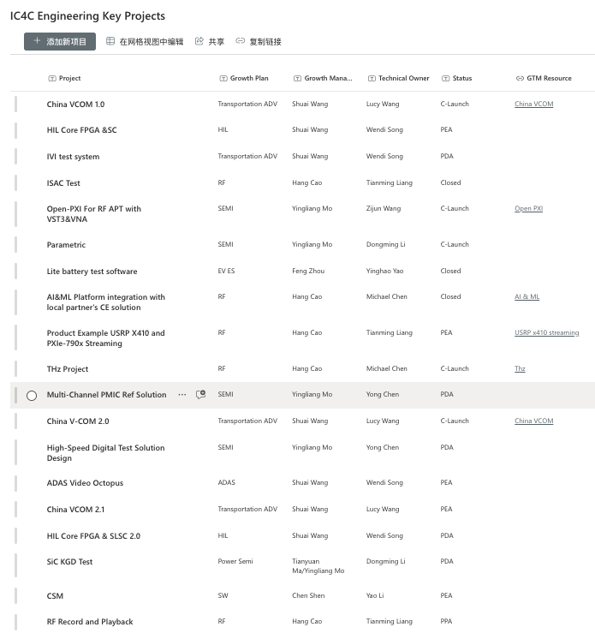
How IC4C SharePoint Supports Sales
If you are a salesperson in automobile industry
If you think a specific feature (e.g. a HIL feature) would help you pursue an opportunity, you can go to:
IC4C SharePoint Homepage >> Engineering Chapters >> HIL Chapter
where you can find if the feature is covered in the latest HIL progress. And if not, you can approach to the HIL growth manager to seek for support.
If you and the growth manager reach consensus on a feature development, the administrator will support you to go through the PEP process, and you can track the PEP progress on:
IC4C SharePoint Homepage >> Progress >> Roadmap and Projects
Solution Development

Slide 14

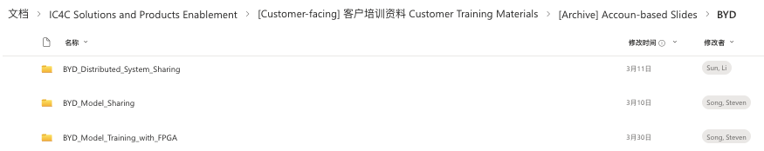
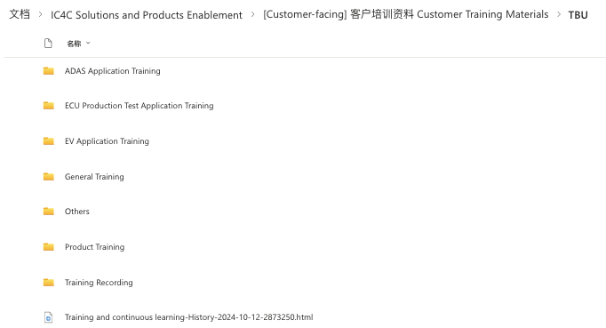
How IC4C SharePoint Supports Sales
If you are a salesperson in automobile industry
If you are planning to hold a training for customers, you can go to:
IC4C SharePoint Homepage >> Customer Training Materials >> [Account-based Slides]
where you can check the history training slides for different automobile customers (e.g. BAIC, BYD, Chang’an)
Customer Training
If you need some product/application-level training materials, you can go to:
IC4C SharePoint Homepage >> Customer Training Materials >>General/TBU

Slide 15
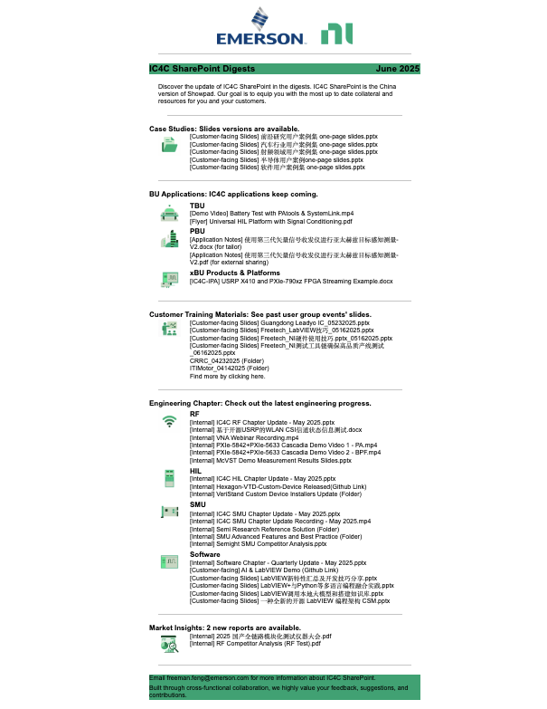
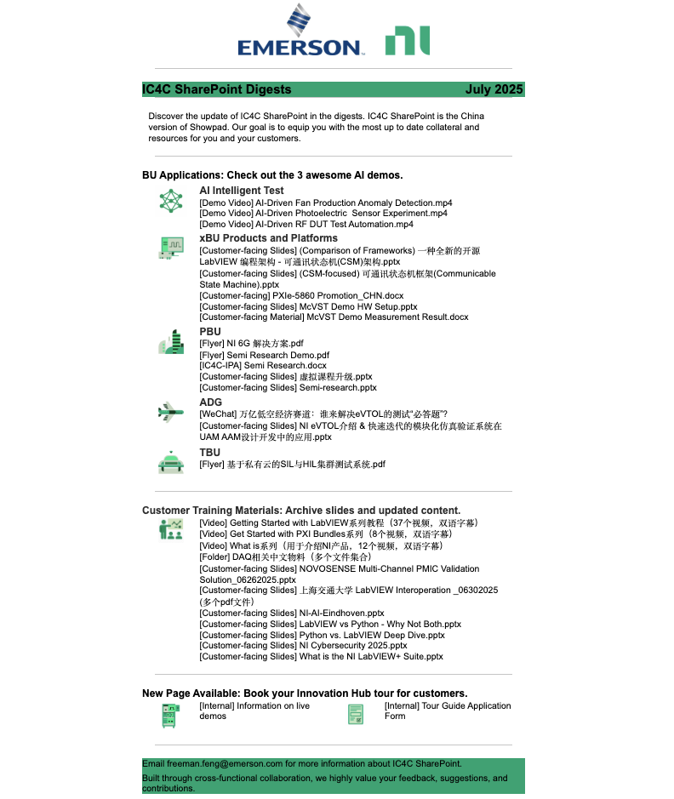
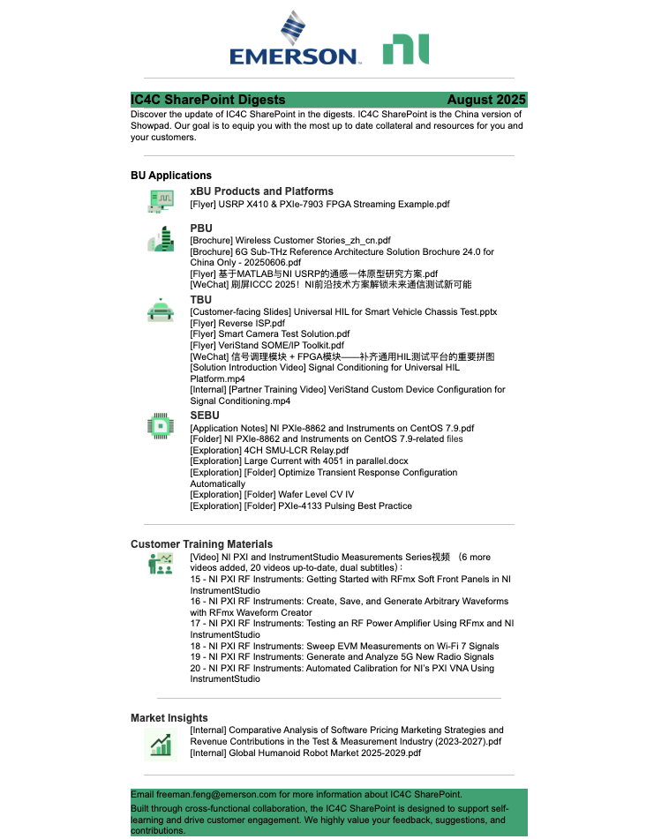
IC4C SharePoint Updates on a Monthly Basis (Starting from June)
Digests of June
Digests of July
Digests of August

